Slide 1
Prediction of Electrical Output Power of Combined Cycle Power Plant Using Linear Regression

Slide 2
Team Members
Ishrat Jahan Ananya - 1631636645
Shadman S. Khan – 1611918042
Shamima Haque Priya - 1620069042
Nabiul Hoque Khandakar - 1631164642

Slide 3
Table Of Contents
Problem
Background Theory
Data Set Description
Visualization
Results
Conclusion

Slide 4
Problem
Using dataset of Temperature, Ambient pressure, relative humidity & relative vacuum we need to predict output power of a combined cycle power plant.

Slide 5
Back ground theory
Using artificial neural network, it is possible to understand the effects certain factors of environment has on the combined chemical power plant
2. Most integrated cycle of power plants work in cyclic conditions. Thus making it hard to determine the facts that has an effect on the electrical power output
3. The target was to create a regression model, which will help us to identify the ecological conditions and the natural factors which will help us to determine the changes brought for the production of the required electrical power

Slide 6
Data Set Description
Temperature (T) in the range 1.81°C to 37.11°C
Ambient Pressure (AP) in the range 992.89 to 1033.30 millibar
Relative Humidity (RH) in the range 25.56% to 100.16%
Exhaust Vacuum (V) in the range 25.36 to 81.56 cm Hg

Slide 7
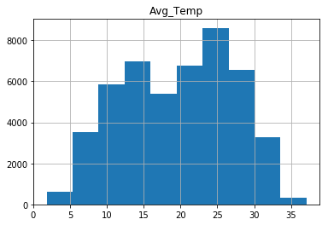
Data Set Description
Temperature (T) in the range 1.81°C to 37.11°C

Slide 8
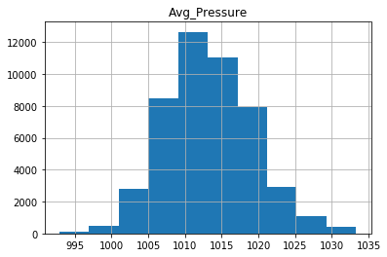
Data Set Description
Ambient Pressure (AP) in the range 992.89 to 1033.30 millibar

Slide 9
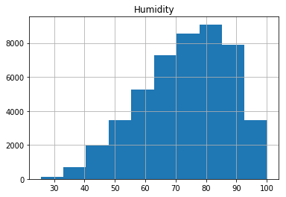
Data Set Description
Relative Humidity (RH) in the range 25.56% to 100.16%

Slide 10
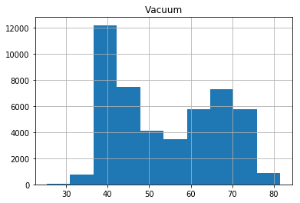
Data Set Description
Exhaust Vacuum (V) in the range 25.36 to 81.56 cm Hg

Slide 11
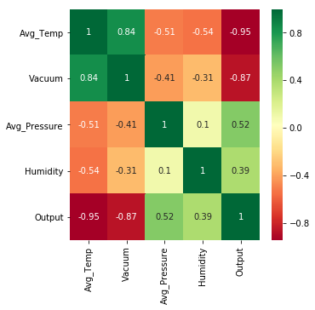
Visualization- Correlation using heatmap

Slide 12
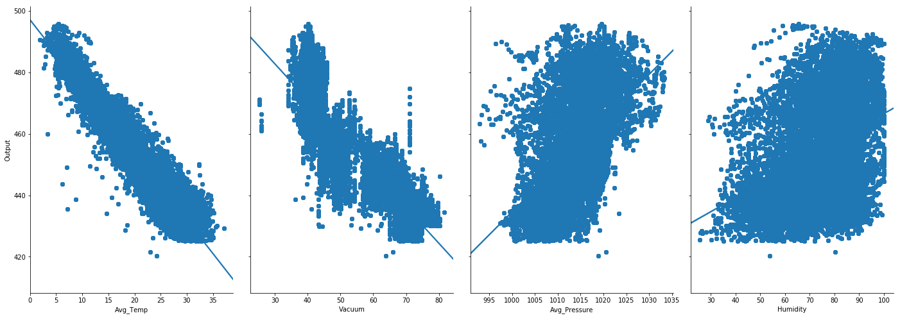
Pairplot

Slide 13
Methodology
Linear Regression model
Based on supervised learning
Performs a regression task
Targets prediction value based on independent variables
Mostly used to find out relations between variable and forecasting

Slide 14
Methodology Contd.
For the multi variable regression the equation will be
y = 454.6093 + (-1.9775) x Avg_Temp + (-0.2339) x Vacuum + 0.06214 x Avg_Pressure + (-0.1581) x Humidity
No need for feature reduction or filtration.

Slide 15
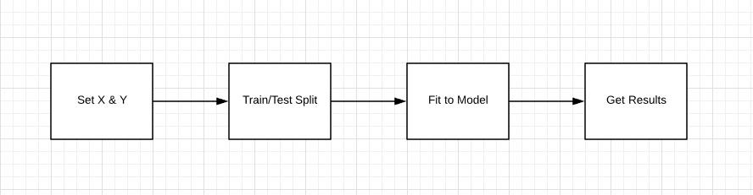
Flowchart

Slide 16
Result
The Results are as follows:
Mean Absolute Error: 3.585560841621613
Mean Squared Error: 20.264638560606443
Root Mean Squared Error: 4.501626212893119

Slide 17
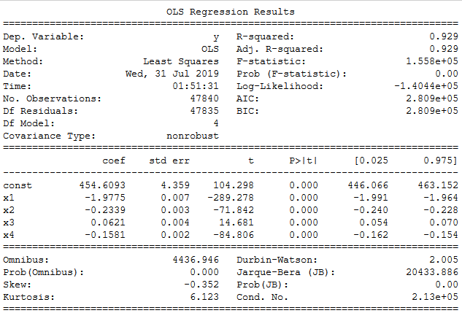
Result Contd.
Our Multivariate Linear Regression model was able to predict the output as the r² score shows

Slide 18
Conclusion
Need more data to get the best possible prediction.
Assuming this data having a linear relationship might not be the case. Visualizing may help with that.
The features we used may not have had a high enough correlations that we were trying to predict.

